Slide 1
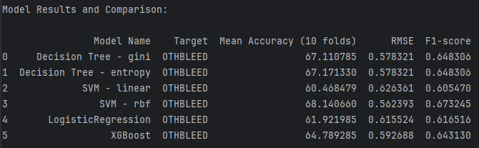
Model Performance (20 f.) – First Week

Slide 2
Data
Pro-processing
Imputation
Encoding
Standardization
10 models
10 models
10 models
Baseline
2018-2020
126 features
2018-2022
126 features
2018-2022
40 features
Feature Selection
f_importances from tree-based models
sklearn.feature_selection
PCA
Featurewiz
Featuretools
Feature Engineering
AutoFeat
Synthetic Data Generation
GANs
Synthetic Data Generation
Bayesian
Auto ML
TPOT
Post-training Analysis & Feature Importance
Classification Report
VIF
Corr Matrix
SHAP
LIME
Deep Learning
CNN
Neural Networks

Slide 3
Data
Pre-processing
Imputation
Encoding
Standardization
Caret
Baseline Models
Decision Tree
Random Forest
SVM
Logistic Regression
Gradient Boosting
XGBoost
NaiveBayes
KNN
TPOT
Feature Selection
f_importances from tree-based models
sklearn.feature_selection
PCA
Feature Engineering
AutoFeat
Featurewiz
Featuretools
Synthetic Data Generation
GANs
Bayesian
Post-training Analysis & Feature Importance
Classification Report
VIF
Corr Matrix
SHAP
LIME
Deep Learning
CNN
Neural Networks

Slide 4
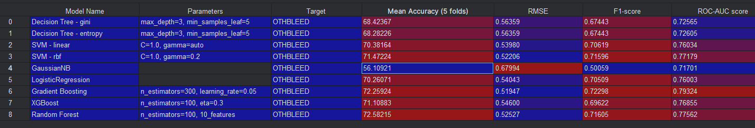
Model Performance
(Better imputation; 43 features selected by Dr. Gupta)
Best model
2nd Best model

Slide 5
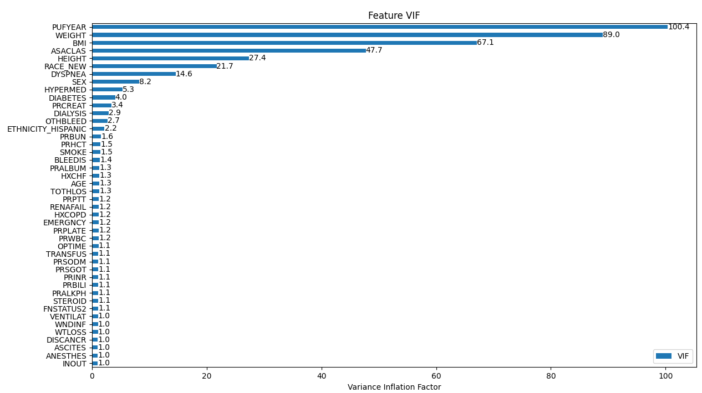
Detecting Multicollinearity

Slide 6
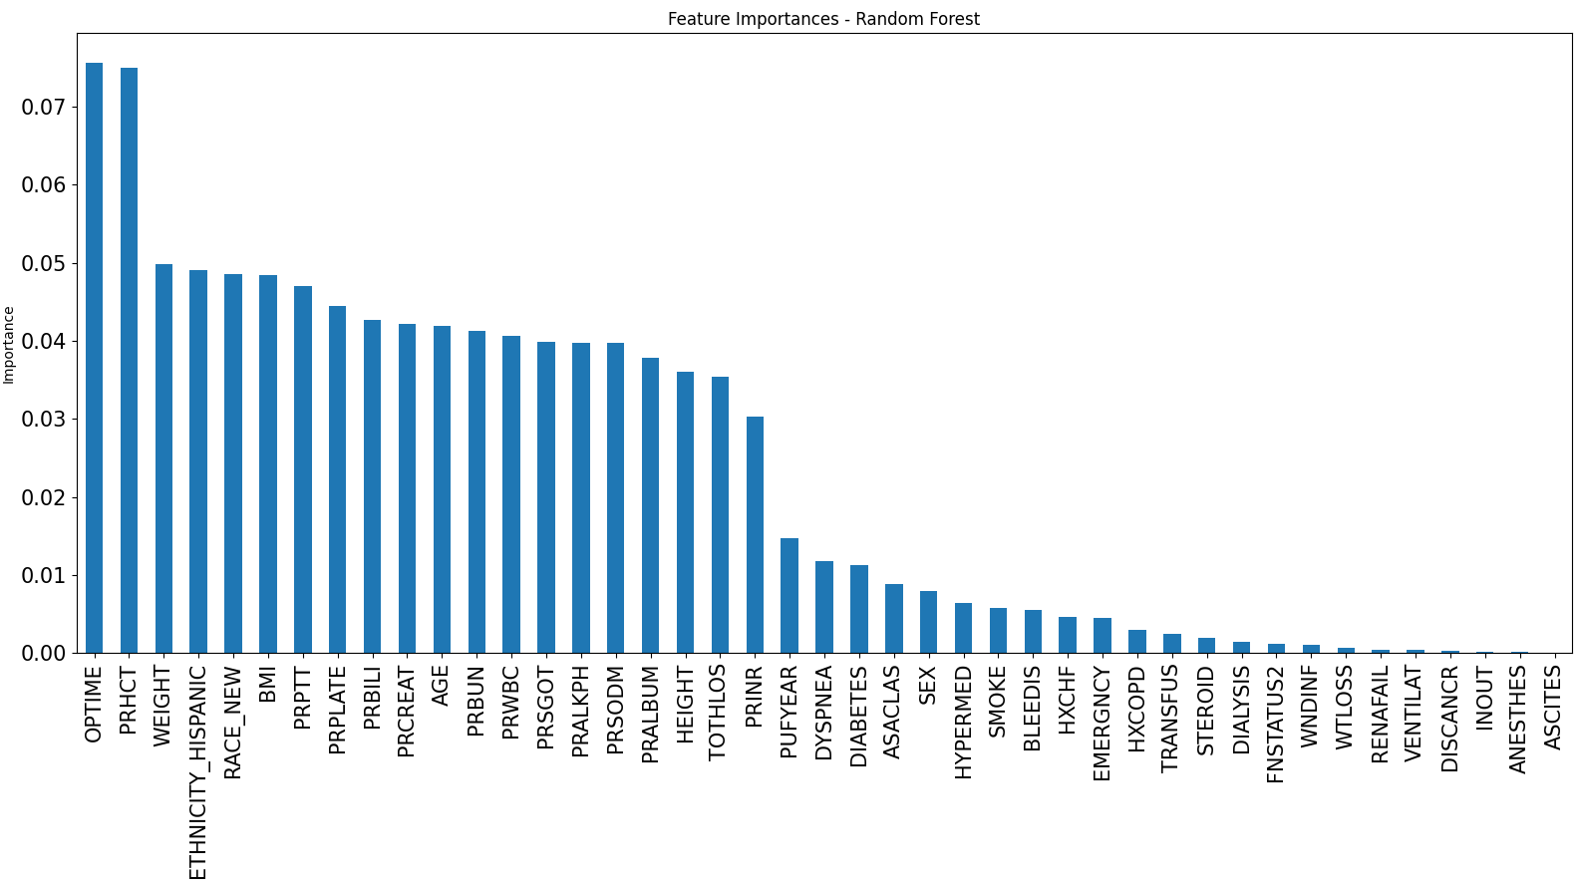
Random Forest (features included = 43)

Slide 7
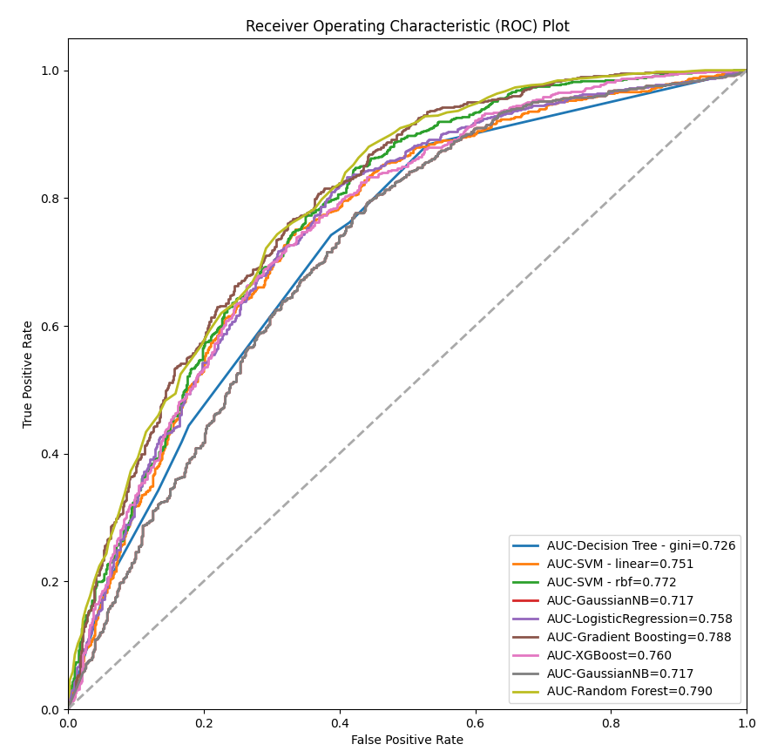
ROC-AUC Comparison (models included = 9)

Slide 8
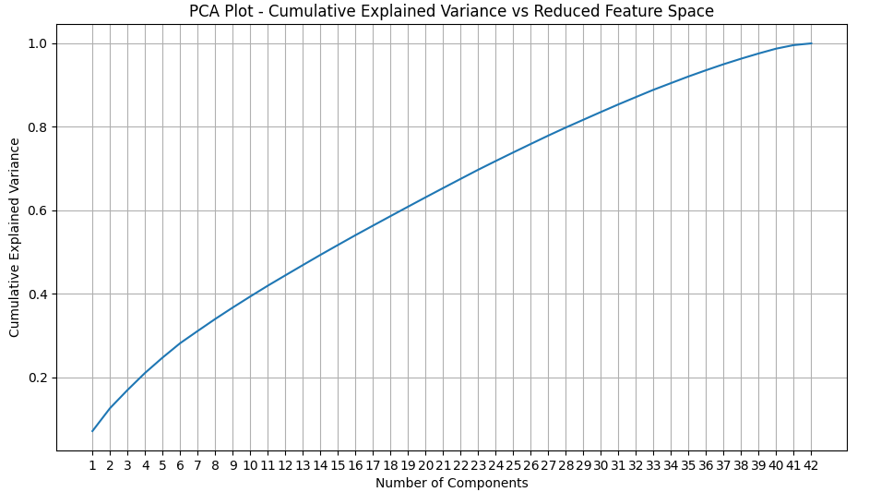

Feature Selection – PCA

Slide 9
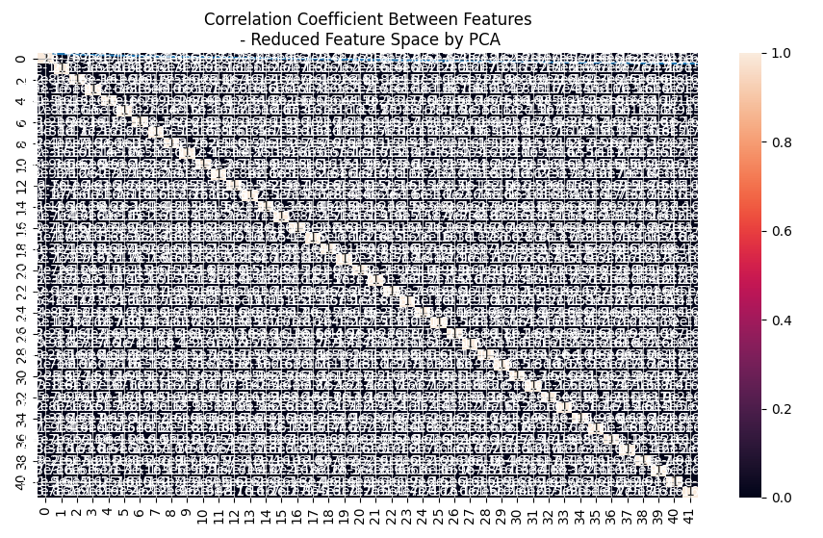
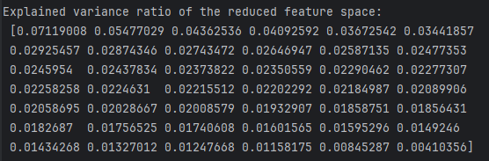
Feature Selection – PCA
Explained Variance Ratio

Slide 10
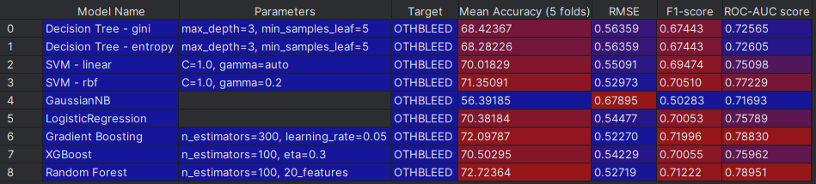
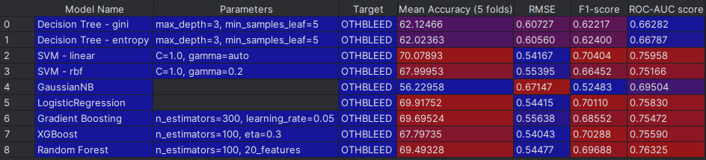
Model Performance (43 f.) – Before Feature Selection
Model Performance (42 f.) – After Feature Selection
Best model
2nd Best model

Slide 11
Backup Slides

Slide 12
Class
class_baseline_decision_tree
DecisionTree
class_baseline_svm
SVM
class_baseline_logistic
LogReg
class_baseline_xgboost
XGB
Utilities
utils_models

Slide 13
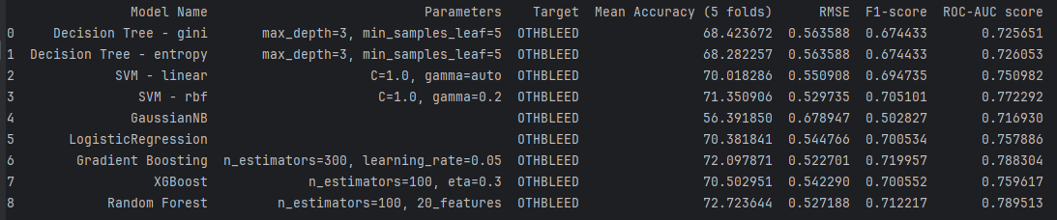
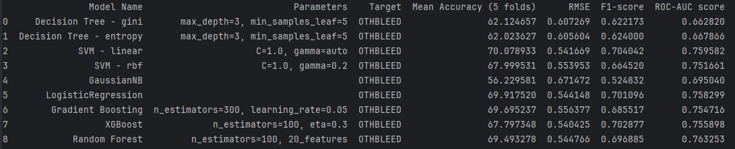
Model Performance (43 f.) – Before Feature Selection
Model Performance (42 f.) – After Feature Selection

